Slide 1





CMSC204
Kartchner
Student: Michael Amaya
V(StateGraph) = {Oregon, Alaska, Texas, Hawaii, Vermont, NewYork, California}
E(StateGraph) = {(Alaska, Oregon), (Hawaii, Alaska), (Hawaii, Texas), (Texas, Hawaii), (Hawaii, California), (Hawaii, New York), (Texas, Vermont), (Vermont, California), (Vermont, Alaska)}
1. Draw the StateGraph
Vermont
Oregon
Hawaii
Alaska
Texas
California
New York

Slide 2
a. Show the adjacency matrix that would describe the edges in the graph. Store the vertices in alphabetical order
States
A
C
H
NY
O
T
V
Alaska
A
0
0
1
0
0
0
1
California
C
0
0
1
0
0
0
1
Hawaii
H
0
0
0
0
0
1
0
New York
NY
0
0
1
0
0
0
0
Oregon
O
1
0
0
0
0
0
0
Texas
T
0
0
1
0
0
0
0
Vermont
V
0
0
0
0
0
1
0
3. b. Show the adjacency lists
that would describe the edges in the graph
Alaska
Oregon
Null
California
Null
Hawaii
Texas
Vermont
California
Null
New York
Null
Oregon
Null
Texas
Hawaii
Alaska
Oregon
Null
Vermont
Alaska
Oregon
Null

Slide 3
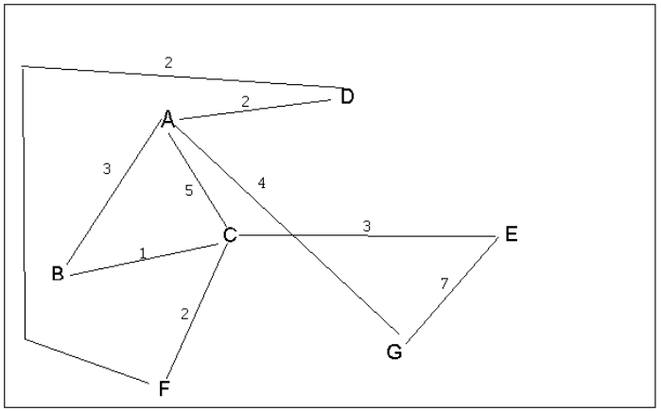
4 a. Which of the following lists the graph nodes in depth first order beginning with E?
A) E, G, F, C, D, B, A
B) G, A, E, C, B, F, D
C) E, G, A, D, F, C, B
D) E, C, F, B, A, D, G
4 b. Which of the following lists the graph nodes in breadth first order beginning at F?
A) F, C, D, A, B, E, G
B) F, D, C, A, B, C, G
C) F, C, D, B, G, A, E
D) a, b, and c are all breadth first traversals

Slide 4
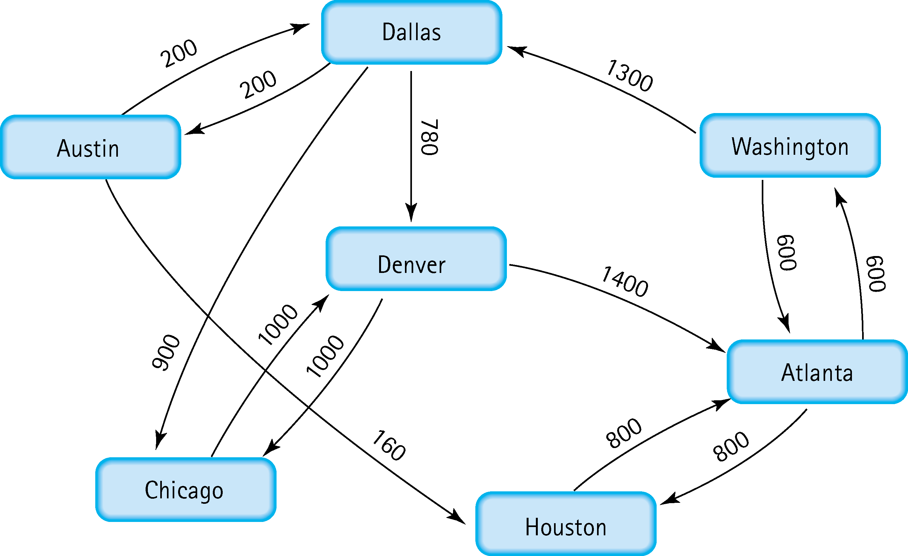
5. Find the shortest distance from Atlanta to every other city
Atlanta
Washington
Atlanta
Houston
Atlanta
Washington
Dallas
Atlanta
Washington
Dallas
Austin
Atlanta
Washington
Dallas
Chicago
Atlanta
Washington
Dallas
Denver

Slide 5
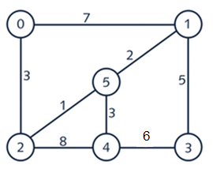


6. Find the minimal spanning tree using Prim’s algorithm. Use
0 as the source vertex . Show the steps.

Slide 6


7. Find the minimal spanning tree using Kruskal’s algorithm.
Show the weights in order and the steps.

Slide 7
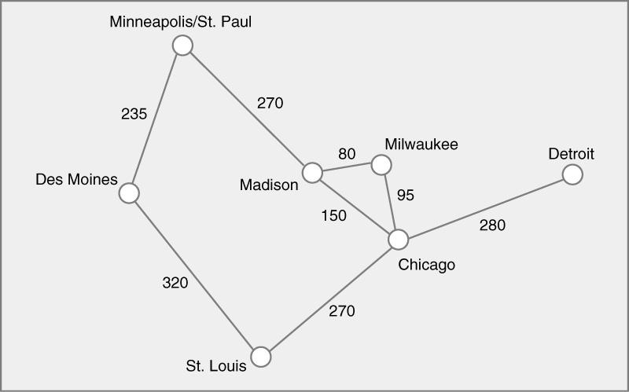




8. Find the minimal spanning tree using the algorithm you prefer. Use
Minneapolis/St. Paul as the source vertex

Slide 8
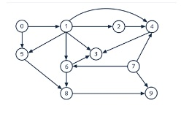
9. List the nodes of the graph in a breadth first topological ordering. Show the
steps using arrays predCount, topologicalOrder and a queue
0
1
2
5
7
6
8
4
3
9

Slide 9
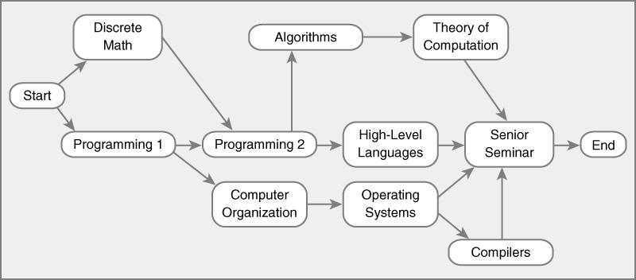


10. List the nodes of the graph in a breadth first topological ordering.
Start
Discrete Math
Programming 1
Programming 2
Computer Organization
Algorithms
High-Level Languages
Operating Systems
Theory of Computation
Compilers
Senior Seminar
End

